Slide 1

DEFIANZ
Open-Source Data De-identification and Anonymization platform

Slide 2
Agenda
Background
Defianz as a Platform
Real World Usage
Defianz Direction
Reference Materials

Slide 3

Background
Setting the stage
EDIT SLIDE SUBTITLE HERE
Some details and core background

Slide 4
What is Defianz
What it is
How It Can be Used
De-identification is about replacing PHI (personal health information) or PII (personally identifiable information) with equivalent-level information and keeping data consistent for the life of all transactions.
Anonymization is about replacing PHI (personal health information) or PII (personally identifiable information) with random information and it does not have to be consistent for the life of all transactions.
As a platform to provide a consistent approach to de-identification and anonymization.
It is intended to be used with DataSynthesis to provide the synthetic data to populate into data streams.

Slide 5

Healthcare Industry Problem(s)
The practice of managing data for application development / Implementations / integrations of systems require lots of resources and technology
Industry standards and government mandates makes the de-identification and anonymization processes and practices defined but cause a lot of confusion, complexity and challenge

Slide 6







Project Herophilus Perspective
Re-imagine how to de-identify an/or anonymize data with a consistent and extensible approach
Core mindset: provide simple yet extensible powerful capabilities that implementations can drive
Follow relevant industry standards – Safe Harbor
Satisfy needs of multiple: development, integration, testing, security and operations
Multiple implementation model support: on-premise, single public cloud, multi-cloud or all of the above

Slide 7


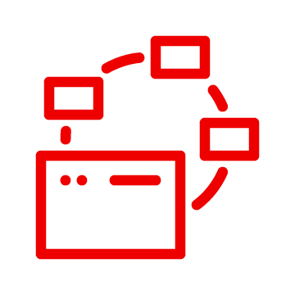



Our Focus: Solve Business Challenges
Business innovation
Technical Enablement and Agility
Operational Simplification
Deliver customer centric value
Show data-driven capabilities
Minimize operational challenges
Enable innovation, increase productivity, and offer better data-driven products and services
Provide data with development, including PaaS and SaaS services
Deliver data seamlessly and consistently with insight

Slide 8
Defianz History
2021
(Started in September)
2022
Brought the concept to the open-source community
Focused on initial needs and building a data model to accommodate base capabilities
Moved from prototypes of data and code into a more formal effort
Initial implementation protype
Revamped the means and way we create internal relationships to data
Enhanced data model to support initial implementation prototype
Initial API development

Slide 9

Defianz
Platform
The Data De-identification and
Anonymization Platform
Implementation Types and Data Tier

Slide 10



Extensibility at the Core
All code is provided on Git Hub at https://github.com/Project-Herophilus/Defianz
RDBMS scripts and data loaders included
APIs are the core means for access – Quarkus APIs are implemented, and Node is coming in 2023 Q1

Slide 11
Data Tier
Dataaatributes
Identitytype
Statuses
Reference
Data
Identities
Crossmaps
PersonIdentities
Datamodel
Crossmaps
Crossmaps_dtl
Crissmaps_persons_dtl
APIs
DataTables
Domain

Slide 12
How It Works
Pre-Work
The Implementation Steps
Define the crossmap: this is based on the application name and organization name
Define specific crossmap details, the field mappings that are PHI/PII that will be replaced by which specific data attributes,
Per the implementation needs, you first leverage the personidentity API. For this API, you must send in a consistent application name, org name, and single data string of ALL the identity information. This creates a hashed value; if ANYTHING changes, the identity created will be different and existing relationships broken.
The next API that is invoked CrossMapRetrieval API, this will locate the specific ID of the person and pull ANY associated data records including what the fields in the current data stream that would be replaced are.
The data that is pulled in from the system for usage with the specific record is stored for future usage and retrieval

Slide 13
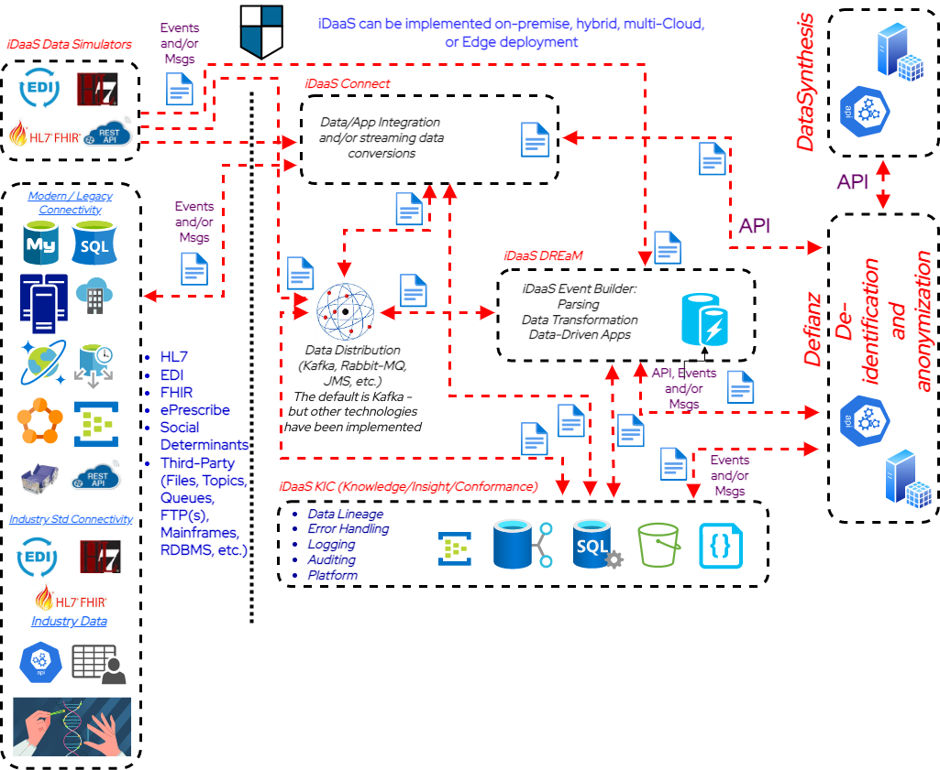
Implementation and Data Flow
All code is provided on Git Hub at https://github.com/Project-Herophilus/Defianz
RDBMS scripts and data loaders included
APIs are the core means for access – Quarkus APIs are implemented, and Node is coming in Q1 of 2023
Implementation types: ETL, Application development, and Data Integration

Slide 14

Real World Usage
How To Use It
EDIT SLIDE SUBTITLE HERE
Implementation focused enabler.

Slide 15

How It is Being Built For Usage
Building
Use to build test data sets that can be used for data simulations
Testing
Testing platforms -
Development, unit, implementation, and performance testing
Development
ETL or areas like application, integration, AI, Cloud, and chatbot development

Slide 16
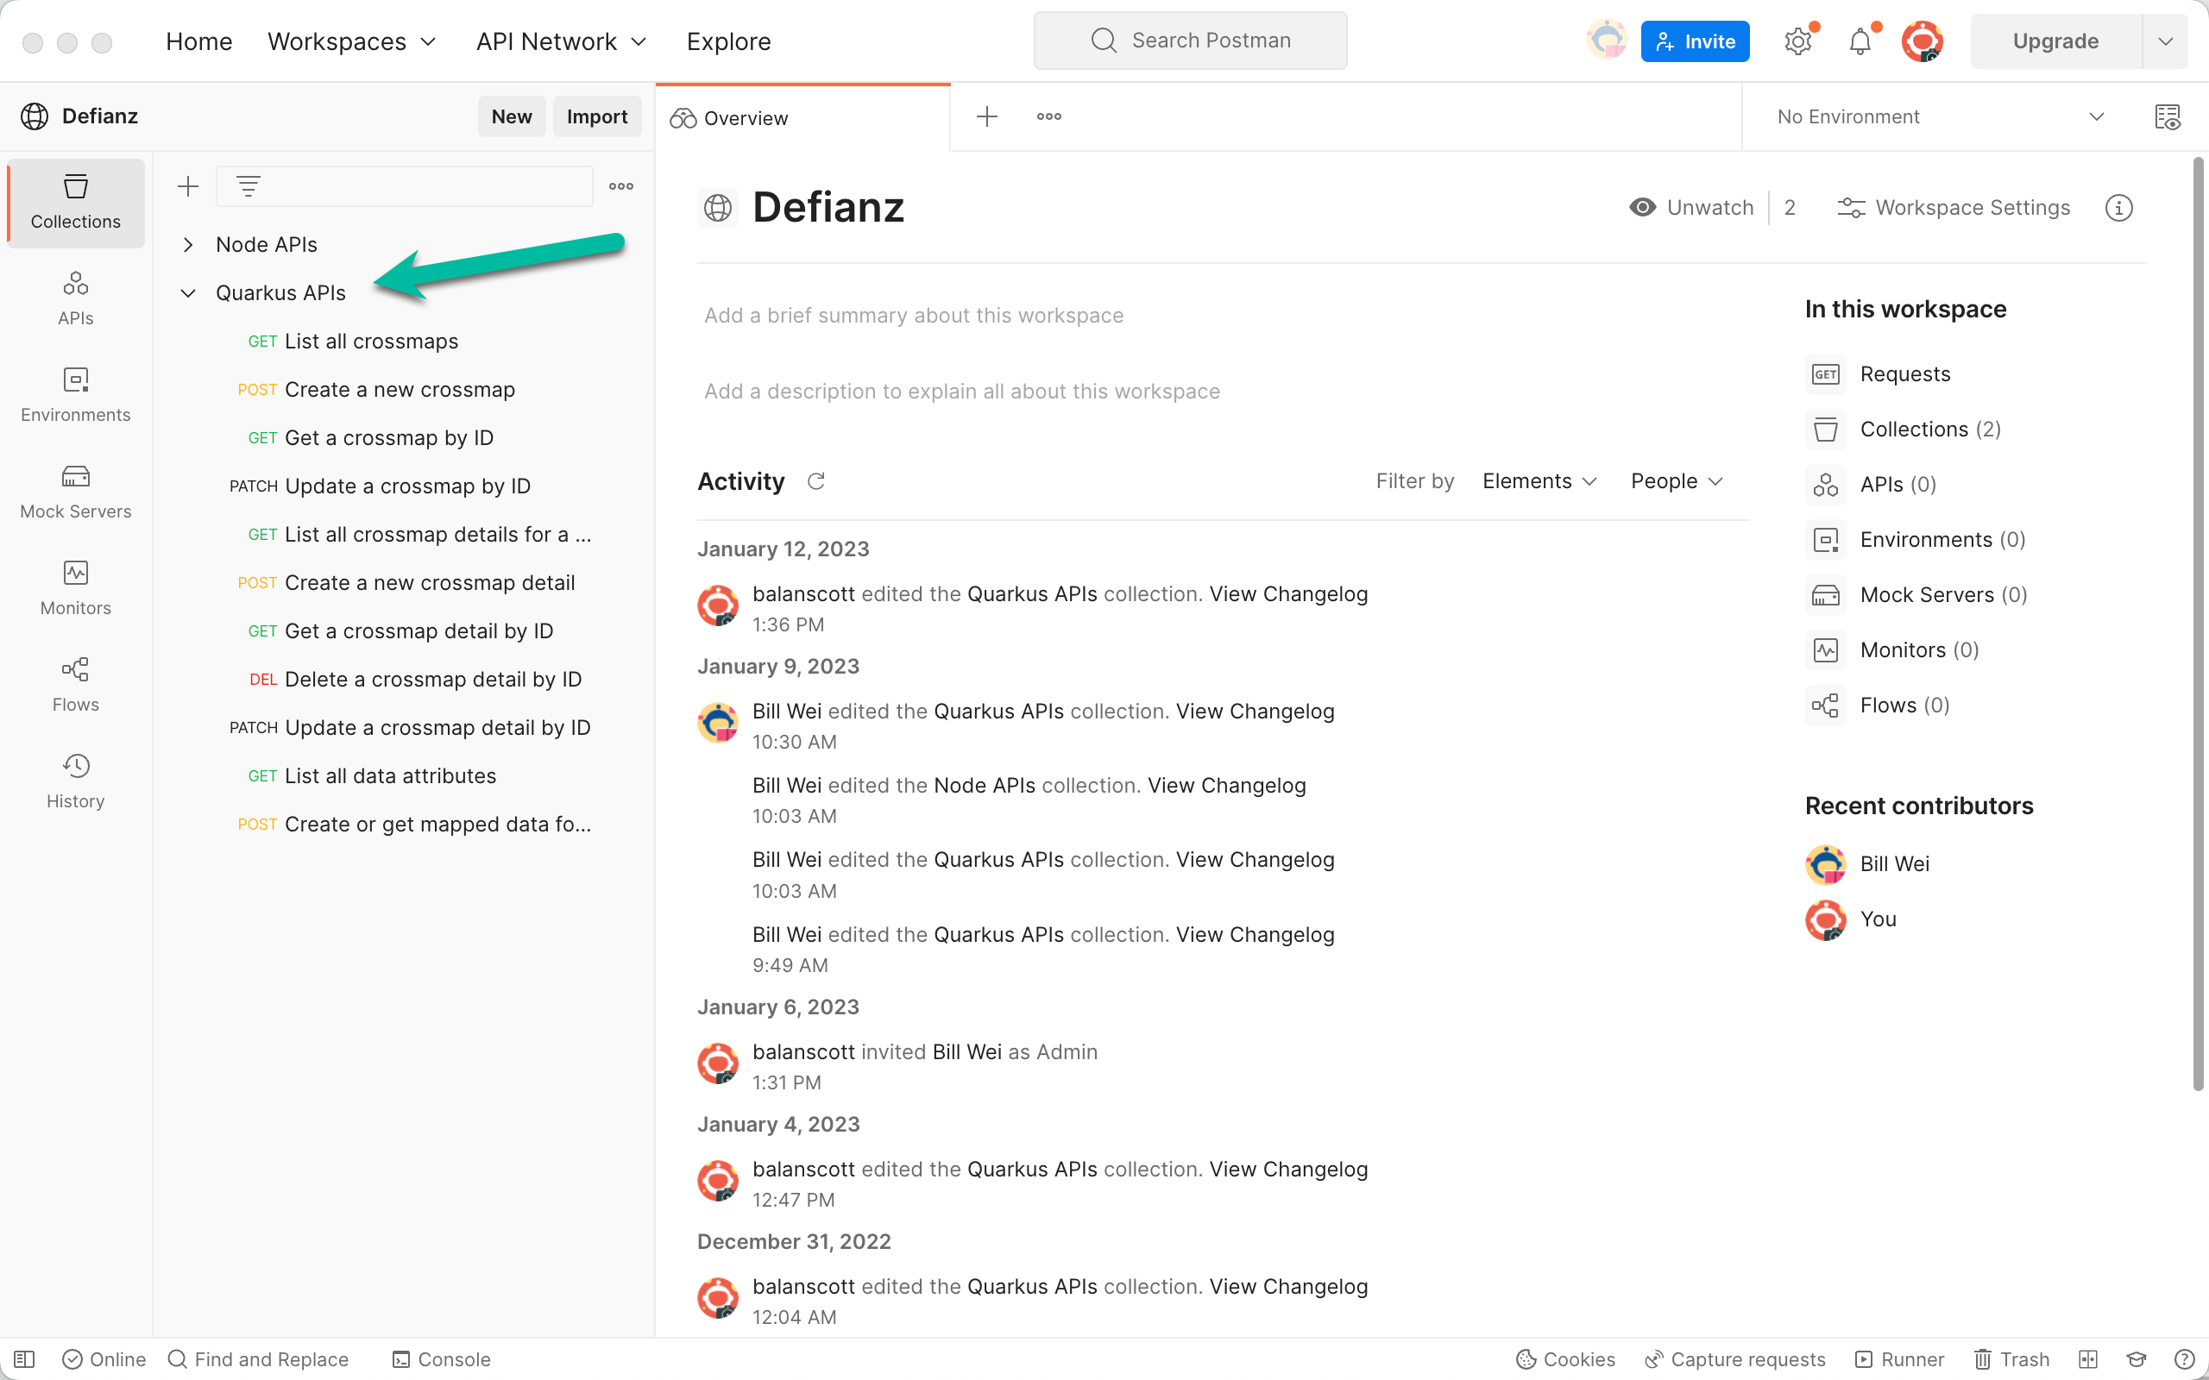
Using APIs: Quarkus
Go the repo and download it https://github.com/Project-Herophilus/Defianz
Setup and implement, then seed your database (if you run the all-in-one container pattern - it puts a small subset of data there).
Go to the DataTier-APIs directory within the project and then to the Quarkus-APIs directory and run this command (all the params are put in based on my implementation): Sample Command: mvn quarkus:dev -Dquarkus.liquibase.migrate-at-start=false -DDATABASE_NAME=defianz -DDATABASE_HOST=127.0.0.1 -DDATABASE_USERNAME=root -DDATABASE_PASSWORD=Developer123 -DDATABASE_PORT=3306 -DskipTests -Dquarkus.hibernate-orm.validate-in-dev-mode=false
Use The Postman link to test quickly: Got to Quarkus APIs folder - Generators and Queries available Defianz Data APIs

Slide 17

Defianz
Direction
Our Future Plans
EDIT SLIDE SUBTITLE HERE
Plans and direction for the future

Slide 18

Defianz Key Direction Tenants
Monthly online meetings
Continue to grow committers and companies leveraging the platform
Finalize implementation model(s)
Extend and enhance the platform – integrate natively with DataSynthesis and iDaaS

Slide 19

Defianz Technical Direction
Platform implementation and integration enhancements
Data model enhancements
Cloud PaaS/SaaS components
New platform capabilities
REACT Web UI

Slide 20


Reference Materials
Supporting Content
EDIT SLIDE SUBTITLE HERE
Any related content for this platform can be located here.

Slide 21
Open-Source Links
Upstream intelligent DaaS GitHub Site: https://github.com/Project-Herophilus/
iDaaS Connect: is how iDaaS can process data from potentially from hundreds of available systems, industry standards and data formats. The ability to connect to/from systems is iDaaS Connect, within this one repository there are dozens of defined modules for connecting to data such as Blue Button, HL7, FHIR, EDI, APIs, Kafka, JDBC, FTP/FTP(s), File, SAP, Cloud Vendor(s) and many more included. While it is one repository it has all the iDaaS Connect branded modules within it.
https://github.com/Project-Herophilus/iDaaS-Connect
iDaaS KIC: KIC (Knowledge, Insight and Conformance). This is the place where all auditing, error handling and iDaaS insight occurs. This platform includes both an internal (iDaaS) and an external data processing capability with endpoints available for easy system connectivity.
https://github.com/Project-Herophilus/iDaaS-KIC
DataSynthesis: Open-Source platform for building synthetic/fictitious data for business/healthcare needs. Has over 100B data attributes for immediate usage and contains over 20+ data-specific areas
https://github.com/Project-Herophilus/DataSynthesis
Defianz: Open-Source platform for de-identification and/or anonymization.
https://github.com/Project-Herophilus/Defianz
Data Simulators: Designed and being implemented to help healthcare resources test iDaaS and validate implementations. Included within several of the modules are the ability to “blast” systems with transactions to performance test as well.
https://github.com/Project-Herophilus/DataSimulators
iDaaS DREAM: DREAM (Data Real Time Enterprise Automation). Implementable and extensible data applications built to support business needs. This repository contains assets developed in Java, JavaScript, and Quarkus.
https://github.com/Project-Herophilus/iDaaS-DReAM
Docker Hub:
All projects are being re-tooled to land in Docker Hub with automated CI/CD automation.howing
https://hub.docker.com/search?q=rhhcarch&source=community

Slide 22
THANK YOU
Join our community, and help us make a difference

